Slide 2

UPDATE
Integrated Personal Commissioning (IPC)

Slide 3
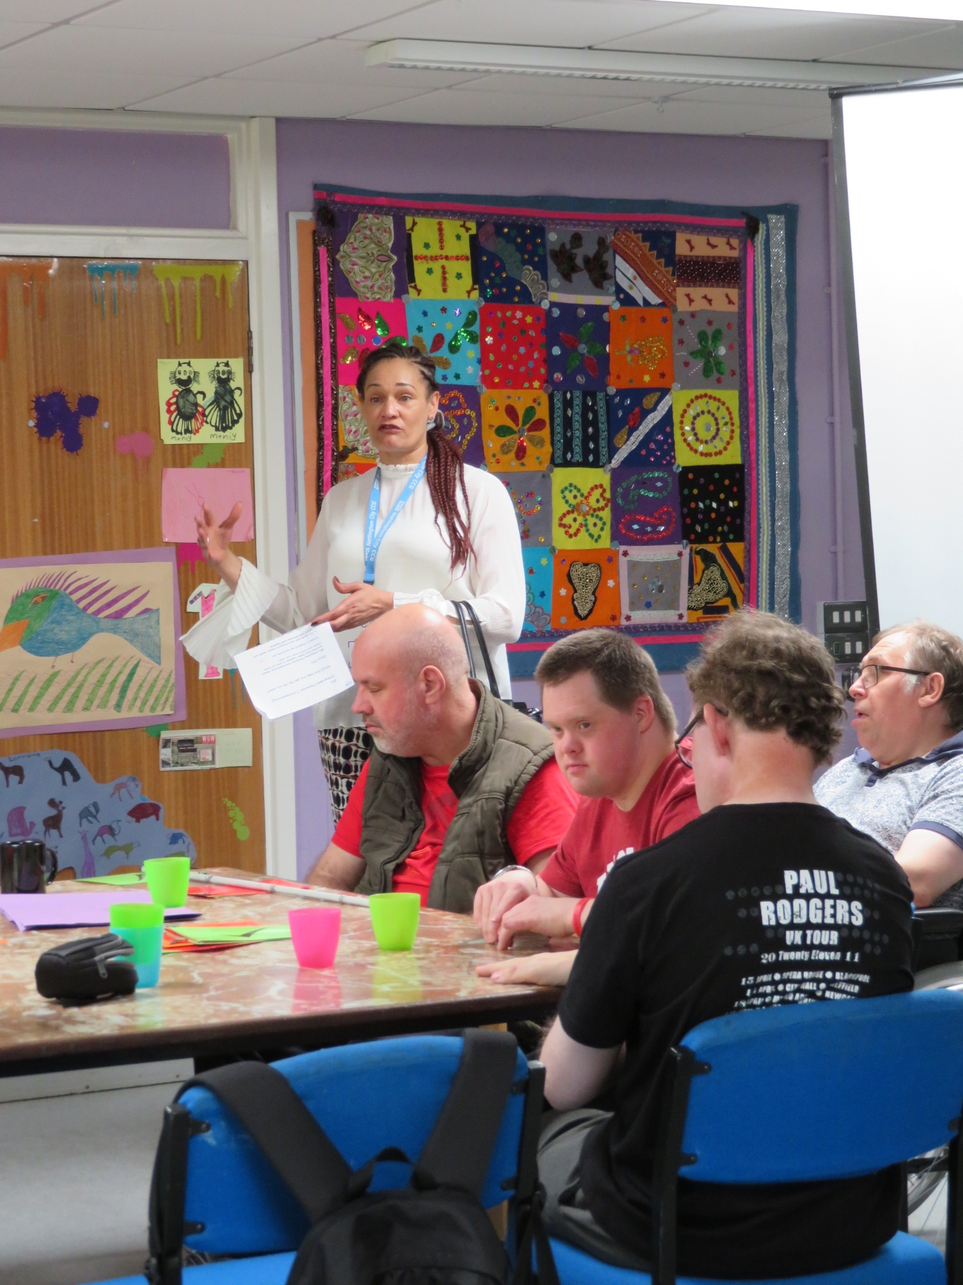
Tinu talked about IPC at the Listening Day

Slide 4

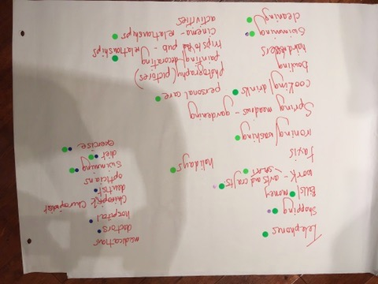
People thought about what it could mean for them
We worked on posters about services people use
green dots for social care
blue for healthcare

Slide 5
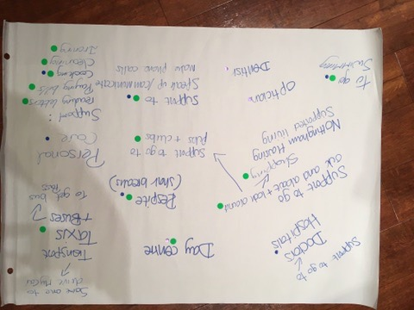
It was sometimes difficult to know who paid for services
A lot of people do not know things they do are ‘services’.

Slide 6
We also asked if some people could use IPC to pay for support to be involved with Splat.
?

Slide 7
We sent the posters and questions to Tinu
We did some more work on this at the Working Group

Slide 8
We talked about IPC at the Working Group

Slide 9
Could people use IPC to pay for support to be involved with Splat?
Could it help with their health and social care needs?
?

Slide 10
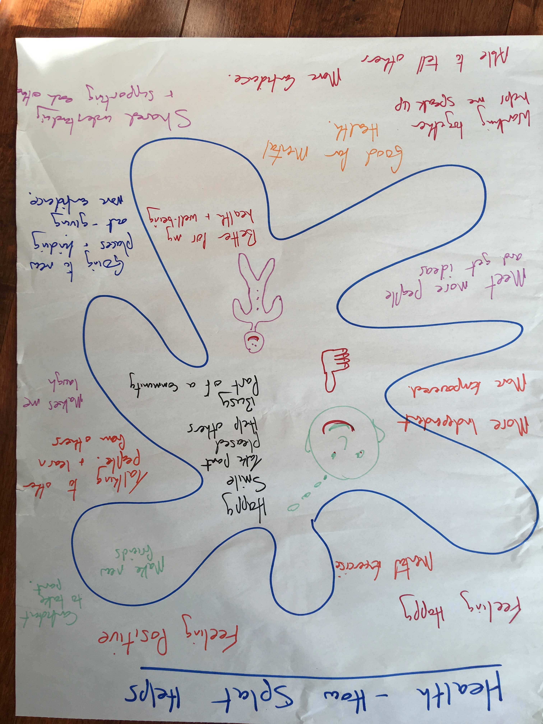
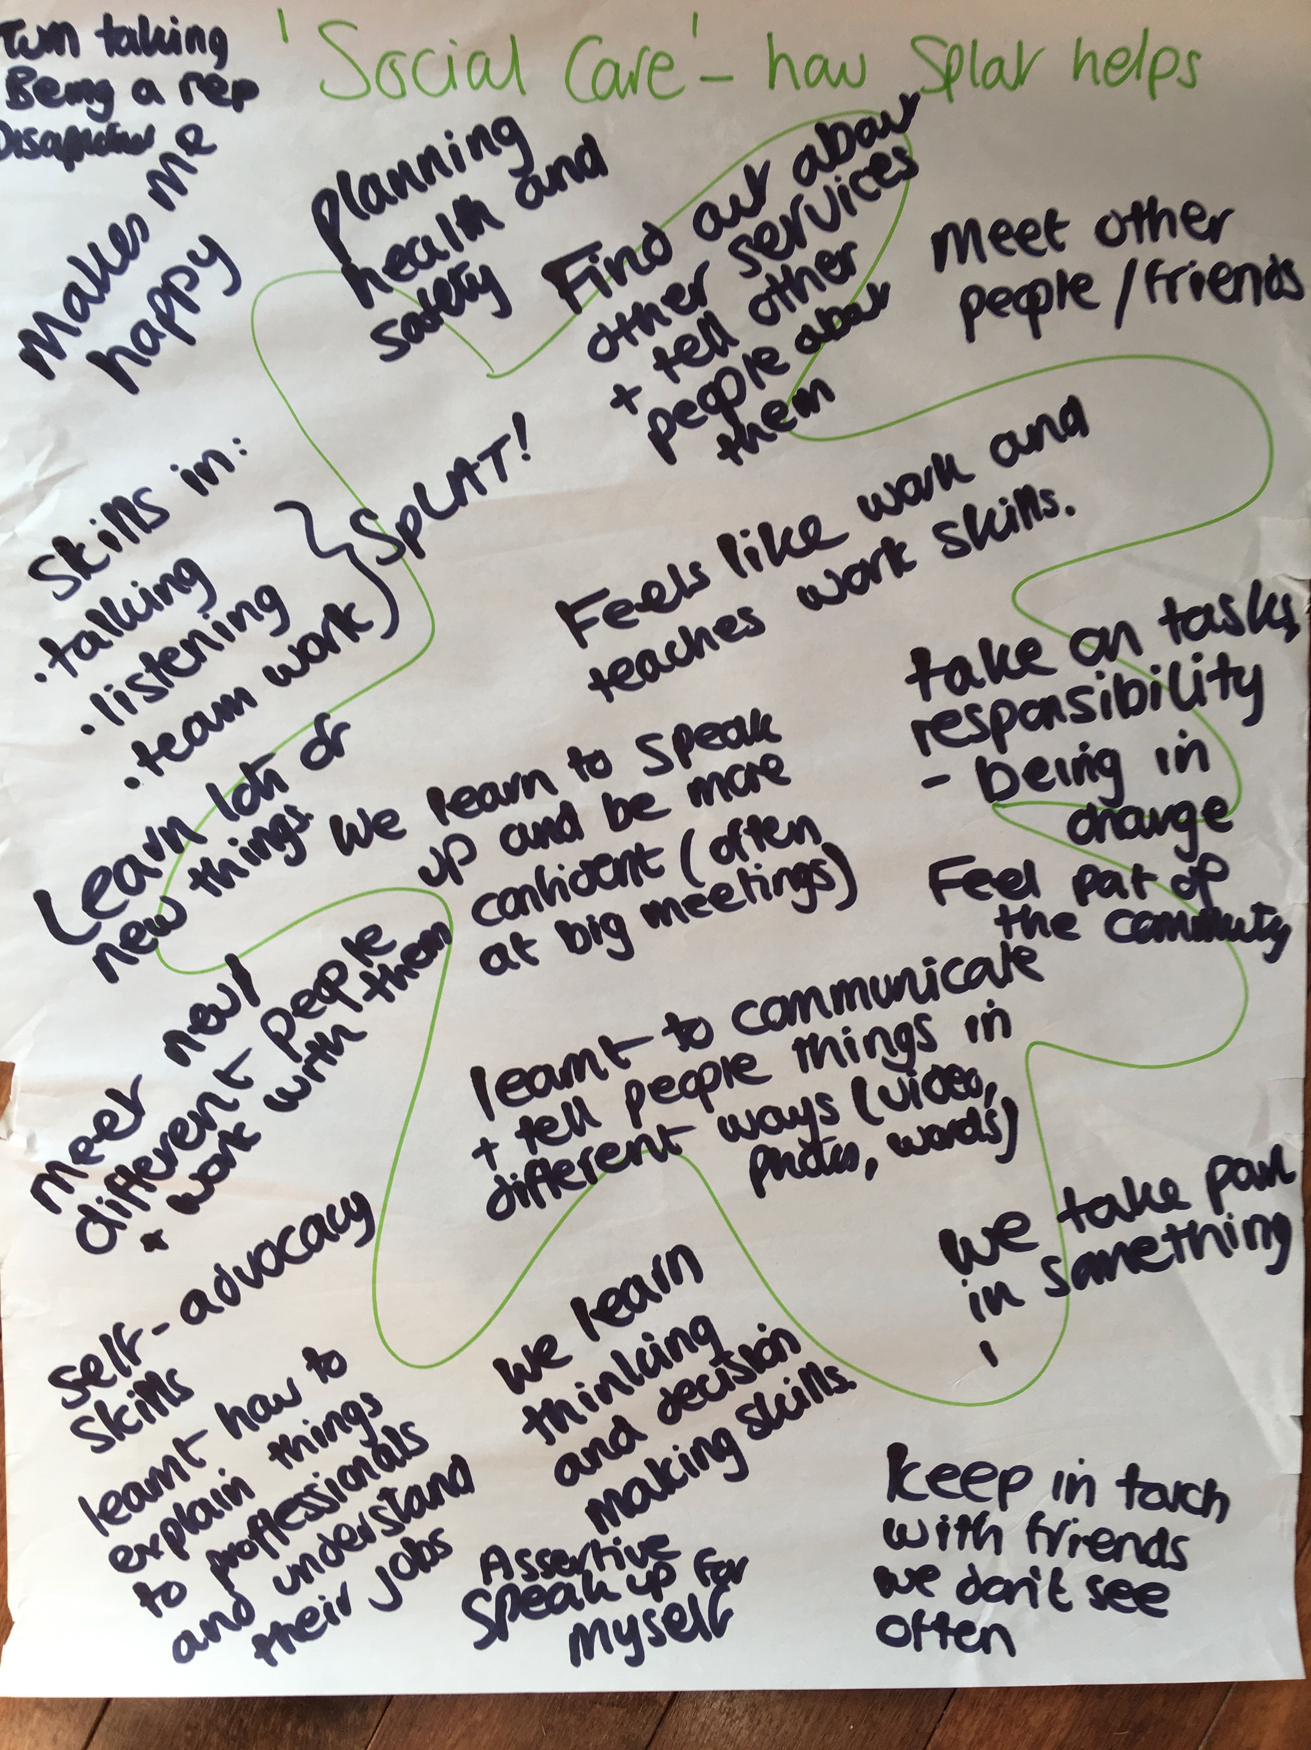
How does working with Splat help with health and social needs?

Slide 11
Splat doesn’t just find out what people think. People also:
Learn new skills
Are part of the community
Get more confident
Meet people
Do something important
Feel good about themselves
+

Slide 12
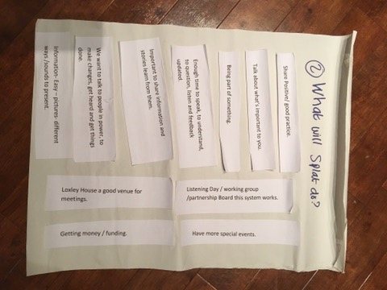
Splat to the Future
Thinking about what we get from Splat got us thinking about other things ……..

Slide 13

We can use these ideas when we:
Register the company
Make rules for how the company works
Get funding

Slide 14

They will also help us to:
Check if things are happening
Check the quality of Splat’s work
Give people a voice in a way that includes all these things.

Slide 15
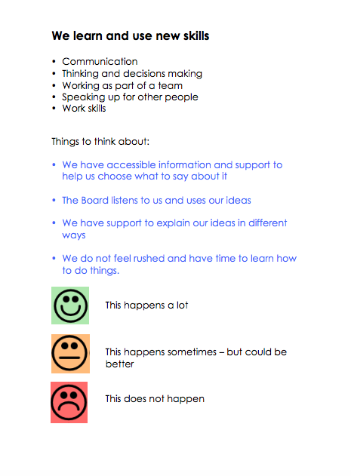
It could be like the Good Services Toolkit

