Slide 1
LD / Autism
Employment Opportunities

Slide 2
Employment for People with Learning Disabilities and or Autism
1. Find out what opportunities already exist.
2. Identify who is out there and who can benefit – Where are they?
3. Can we get some people a job or into activities that will lead to a job?

Slide 3
How can we now take this further ? What can we do ? What support can we expect ?
Challenge set for Departmental Leadership Team

Slide 4
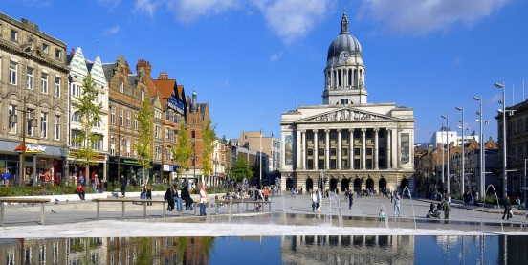
Connecting people: City Council Director with Head of 6th Form at a local school. Outcome: Supported Internship for a young person which has led to a permanent job.
What are we doing ?

Slide 5
Connecting people: Team Leader within Day Services has developed connections with a local community café and charity shop in Nottingham. This now provides a variety of volunteering and life skill opportunities that citizens are now getting involved in. Citizens helping out at a warden aided complex at their tea/coffee mornings and providing companionship to residents in the complex. Outcomes: Developing skills, knowledge and experience that is work related. Skills evidenced through achievement proformas which can be used to show potential employers.
What are we doing ?

Slide 6
Connecting people: A Day Centre luncheon club where citizens from the local community attend have citizens from another day service helping with serving meals. Outcome: Supporting people with learning disabilities and autism to interact with the general public that enables the development of their social skills as well as developing practical skills that could lead to employment opportunities.
What are we doing ?

Slide 7
Connecting people: A post 16 student who has struggled with anxiety and has had panic attacks that left them isolated to the outside world has been connected with a Community Garden and a Parks Ranger. Outcomes: Increased confidence, self esteem and social interaction. Development of pride and sense of purpose. Learning to take instruction and learning new skills These sessions have opened up a whole new world for this young person and talks about doing this for a career.
What are we doing ?

Slide 8
Connecting people: A young person with health and learning difficulties came from School and started working a few hours and is now working one day per week with the Park Rangers. Outcomes: This young person has thrived in this environment and showed improvement in many areas of their personal life as a result. They are paid for their work and has become honouree member of the Park Ranger Team. They have gained more independence in their life, which has also then allowed their mother to keep her part time job. With increased confidence the young person is now able to go into town once a month and treat themself to something new with their wages.
What are we doing ?

Slide 9
Connecting people: A young person with diagnoses of Autism and ADHD, supported through an Education Health and Care Plan attended School until July 2015. Has spent a year on a traineeship working with animals and then started on a supported internship program with College in September 2016. They now have an employment placement with the Co-Op. Outcomes: This young person doing so well the Coop are expecting to offer a paid position after Easter 2017 when the person has turned 18, increasing to full-time work after July 2017 when the academic elements of the college programme are complete.
What are we doing ?

Slide 10
Connecting people: A young person with learning difficulties supported without an EHCP in a mainstream setting attended a local Academy since 2010 and stayed on in September 2016 to take part in a supported internship program run by the school in partnership with an LD charity. Their employment placement is with a major Pub chain as they are keen to work in a customer facing role, Outcomes: This young person has progressed well, gaining confidence and independence, increasing their working hours over time and becoming part of the team. The young person has expressed a preference to go to FE college next year and the Pub chain have asked the person to consider taking a part-time job with them alongside the college course.
What are we doing ?

Slide 11
What are we doing inside the Council ?
Job Roles
Reviewing Job Descriptions / Person Specifications with a focus on general responsibilities rather than specific tasks
Creating Job Descriptions supported by appendix of ‘specific objectives’, which address the appointed individual’s needs
Reviewing ‘specific objectives’ regularly, both task and behaviour orientated, (weekly/fortnightly)
Developing a framework alongside the JDs

Slide 12
What are we doing inside the Council ?
Preparation for Job Carving
Current Job Evaluation Scheme does not lend itself to roles loaded in particular areas – e.g. relationship building
Initial/draft JDs put through evaluation to set a benchmark
Listen & take account of needs of colleagues with autism
Individuals are likely to develop confidence as they settle into role
Need to make sure roles are not stripped out too much, as they will not sustain the appropriate grade

Slide 13
What are we doing inside the Council ?
Support in Role
Important to have a tailored induction into role
Consider expectations of manager, colleagues, & internal customers
Specific Objectives, need to stretch the colleague realistically, and allow for development…. ‘small steps’.

Slide 14
What are we doing inside the Council ?
Equality Action Plan
Children & Adults Department includes a target in their Equality Action Plan to improve employment for those with a Learning Disability and or Autism:
‘Promote and embed a culture of providing work for people with LD / Autism within the council.
Review our progress and set a target of opportunities for 17/18’.

Slide 15
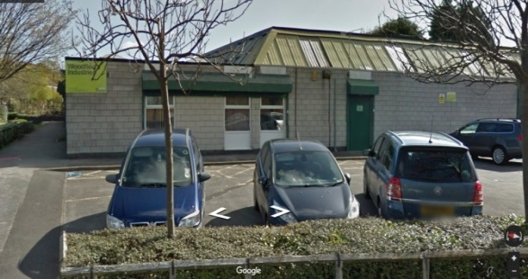
Woodfield Industries Who are they ? A very long established Supported Employment service within the City Council that enables disabled people to access employment opportunities. Their role is currently being modernised to fit with the Council’s objectives around increasing the numbers of employment opportunities which includes supported internships, traineeships, apprenticeships, job coaching and employer support that lead to permanent jobs.
What are we doing inside the Council ?

